Slide 1
Advanced Geospatial Data Analytics: MapReduce and Geospatial data handling
Junjun Yin
CyberGIS Center for Advanced Digital and Spatial Studies
Department of Geography and Geographic Information Science
National Center for Supercomputing Applications (NCSA)
University of Illinois at Urbana-Champaign, IL, 61801
jyn@illinois.edu
March 8th, 2016

Slide 2
Outline
Python programing basics
Hadoop Streaming API with Python
Take advantage of the mapper for parallel processing
Geospatial processing in Hadoop
Case study
Existing tools and frameworks
Write your own geospatial processing pipeline with Python
Leveraging the existing geospatial libraries as packages in Python

Slide 3
Python Programing Basics
For this unit, let’s follow the attached document and review some basics in Python programing
Different coding environments
Choose your favorite code editor

Slide 4
Hadoop Streaming API with Python
Notes:
Pig was created at Yahoo. To make it easier to analyze the data in your HDFS without the complexities of writing a traditional Mapreduce program.
Pig abstract away these complexities.
Internally it creates a sequence of MapReduce jobs,

Slide 5
MapReduce
Let’s recap on what is the MapReduce paradigm
Can you separate each step as individual process
If yes, how?
Can you come up with some scenarios?

Slide 6
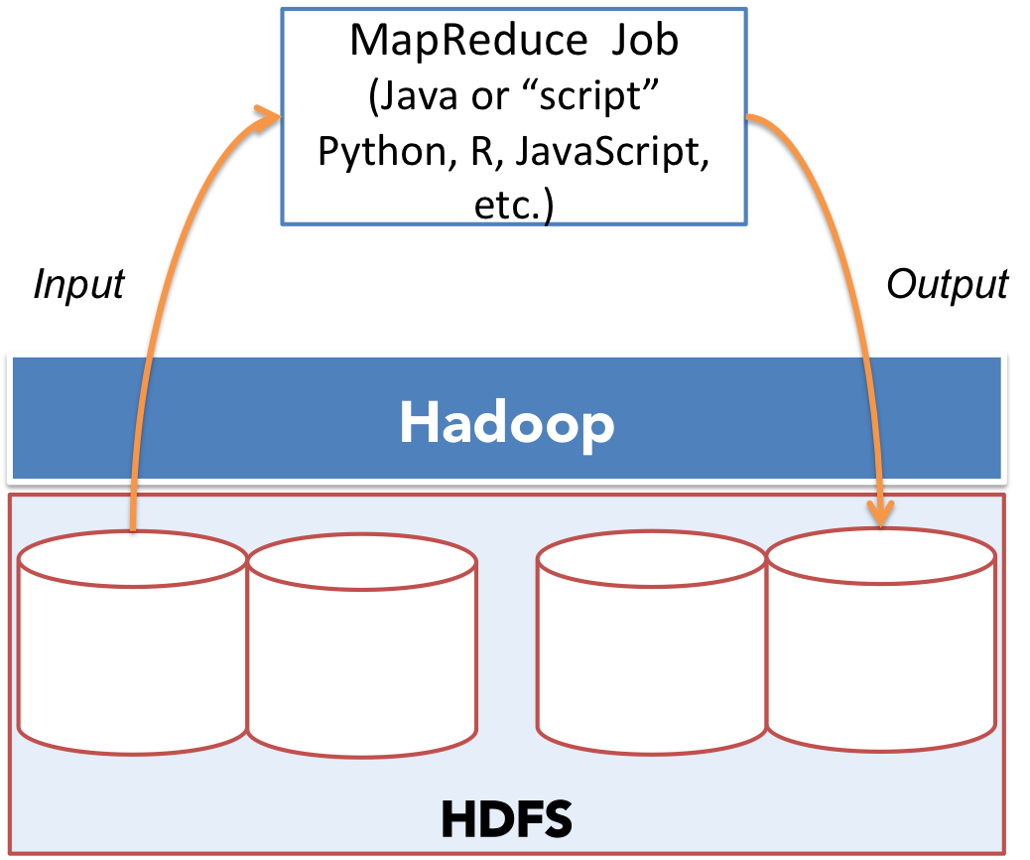
Delegation of Map and Reduce tasks

Slide 7
Example
import time
import datetime
mFile = open("ny_taxi_2013.csv","rb")
mOutput = open("ny_taxi_2013_unix.csv","wb")
for line in mFile:
lineArray = line.split(',')
pickup = lineArray[5]
dropoff = lineArray[6]
pickup_date = pickup.split(" ")[0]
dropoff_date = dropoff.split(" ")[0]
pickup_unix = datetime.datetime.strptime(pickup,"%Y-%m-%d %H:%M:%S").strftime("%s")
if pickup_date > '2013-03-09' and pickup_date < '2013-11-03':
pickup_final = int(pickup_unix) - 5 * 3600
else:
pickup_final = int(pickup_unix) - 6 * 3600
…
newLine = line.replace("\n",",") + str(pickup_final) + ',' + str(dropoff_final) + '\n‘
mOutput.write(newLine)
7
Notes:
7

Slide 8
Hadoop streaming API with Python
#!/usr/bin/env python
import sys
import os
import time
import datetime
for line in sys.stdin:
lineArray = line.strip().split(',')
pickup = lineArray[5]
dropoff = lineArray[6]
…
newLine = line.replace("\n",",") + str(pickup_final) + ',' + str(dropoff_final) + '\n‘
print newLine
8
Notes:
8

Slide 9
Run Hadoop Streaming Job
hadoop jar /usr/hdp/2.3.2.0-2602/hadoop-mapreduce/hadoop-streaming-2.7.1.2.3.2.0-2602.jar -file mapper.py -mapper mapper.py -input ny_taxi_2013.csv -output ny_taxi_2013_unix.csv
yarn jar /usr/hdp/2.3.2.0-2602/hadoop-mapreduce/hadoop-streaming-2.7.1.2.3.2.0-2602.jar -file mapper.py -mapper mapper.py -input ny_taxi_2013.csv -output ny_taxi_2013_unix.csv

Slide 10
Using Python libraries for data analytics
One step further
Numpy, Scipy, Pandas, scikit-learn
Problems
Module load does not work
Each node in Hadoop cluster should have the python framework enabled
Solution
Virutalenv (python virtual environment)
10
Notes:
10

Slide 11
Using Python libraries for data analytics
>>> virtualenv-2.7 demoenv
New python executable in demoenv/bin/python2.7 ... done.
>>> virtualenv-2.7 --relocatable demoenv
>>> source demoenv/bin/activate
>>> pip install “some module”
>>> zip –r ../demoenv.zip *
>>> hdfs dfs –copyFromLocal demoenv.zip
11
Notes:
11

Slide 12
Using Python libraries for data analytics
hadoop jar /usr/hdp/2.3.2.0-2602/hadoop-mapreduce/hadoop-streaming-2.7.1.2.3.2.0-2602.jar
....files
-archives hdfs://cg-hm11.ncsa.illinois.edu/user/jyn/demoenv.zip#demoenv
In your python script
#!./demoenv/bin/python
import your_module
12
Notes:
12

Slide 13
Geospatial processing in Hadoop
Notes:
Pig was created at Yahoo. To make it easier to analyze the data in your HDFS without the complexities of writing a traditional Mapreduce program.
Pig abstract away these complexities.
Internally it creates a sequence of MapReduce jobs,

Slide 14
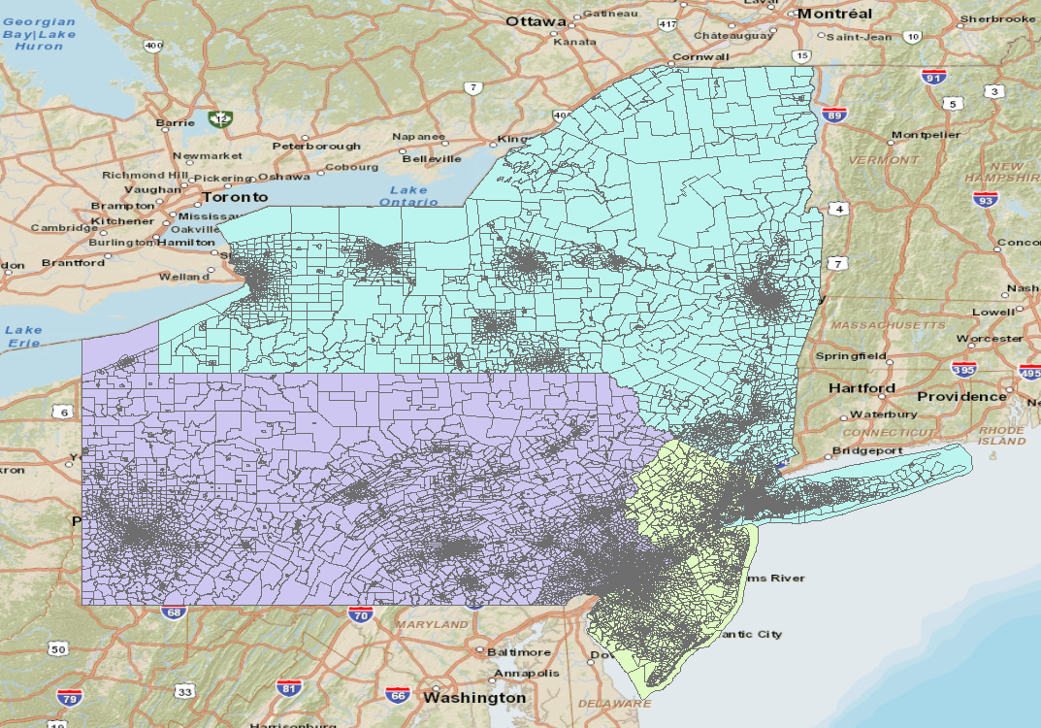
Case study
Aggregating New York taxi records to traffic analysis zones
Notes:
To enter Grunt, invoke Pig with no script or command to run. Typing: pig

Slide 15
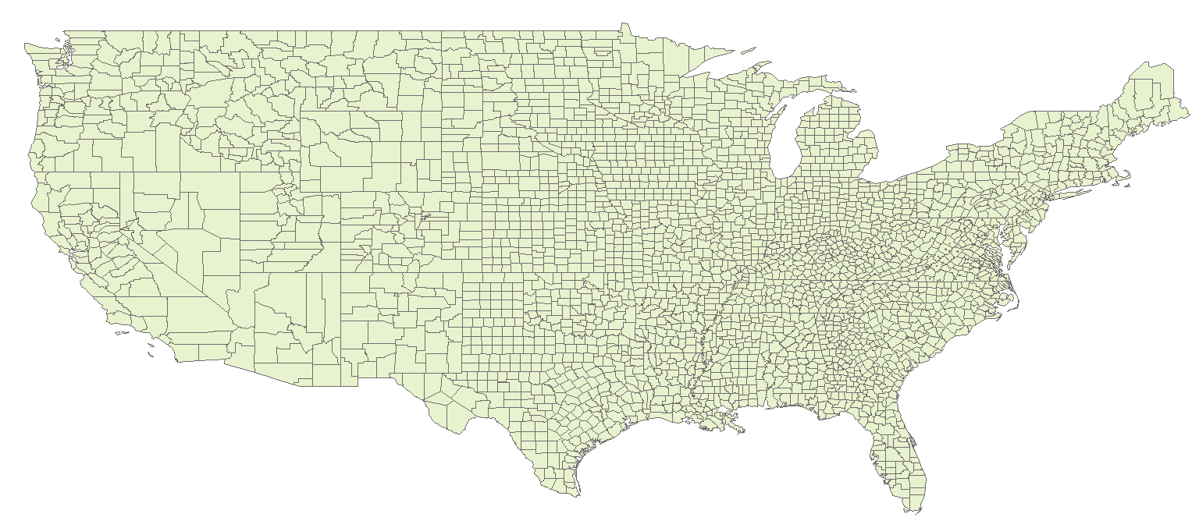
Case study
Aggregating Twitter data to the corresponding county
Notes:
To enter Grunt, invoke Pig with no script or command to run. Typing: pig

Slide 16
Ideas?
16
Notes:
16

Slide 17
Geospatial Operations
Topology operations
Validating geometry, geometry relationships
Intersection
Intersect
Overlapping
Touch (sharing a boundary)
etc.
Spatial Query
Geo-within (Range query)
K-NN (nearest neighbors)
etc.
Notes:
To enter Grunt, invoke Pig with no script or command to run. Typing: pig

Slide 18
Open Source Geospatial Libraries
SDBMS (spatial database management system)
QGIS
ArcGIS
GRASS GIS
Open source libraries: OSGeo
GDAL
Fiona
Shapely
Shapefile.py
Notes:
Next, I would like to talk about frequently used operators.
Load/Store functions
Diagnostic operators
Dump is particularly useful during debugging and prototyping sessions.

Slide 19
Existing distributed computing resources
SpatialHadoop
http://spatialhadoop.cs.umn.edu/
SpatialSpark
https://github.com/syoummer/SpatialSpark
Notes:
Int: a 32-bit signed integer
Long: a 64-bit signed integer
Float: 32 bit floating-point number
Double:64 bit floating-point number

Slide 20
Shapefile.py
Basically, instead of
https://pypi.python.org/pypi/pyshp
Example usage
>>> myshp = open("shapefiles/blockgroups.shp", "rb")
>>> mydbf = open("shapefiles/blockgroups.dbf", "rb")
>>> r = shapefile.Reader(shp=myshp, dbf=mydbf)

Slide 21
Improve efficiency with spatial indexing
The purposes of spatial index
Improve search efficiency
Deal with multi-dimensional dataset
Different types of spatial index
Quad-Tree
R-Tree
octree
Kd-tree
….
For this course, we will demonstrate and use Quad-Tree

Slide 22
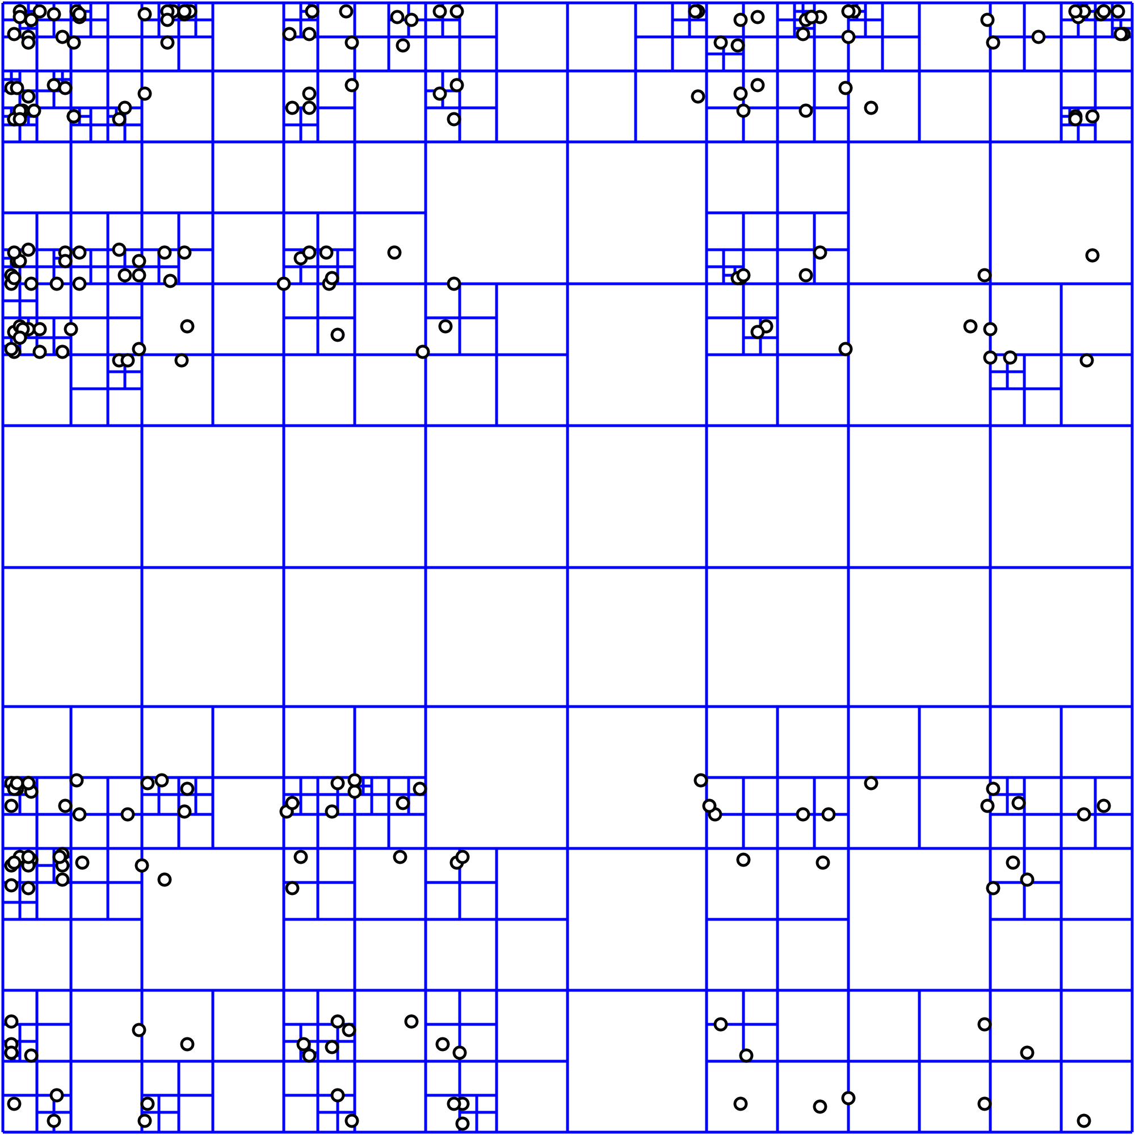
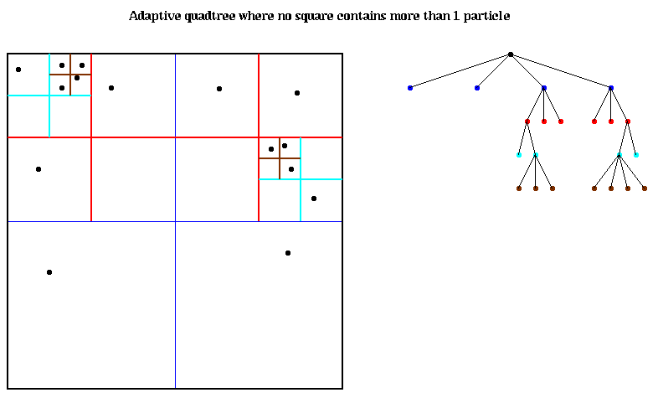
Illustration of Quad-Tree for indexing points

Slide 23

Illustration of Quad-Tree for polygons

Slide 24
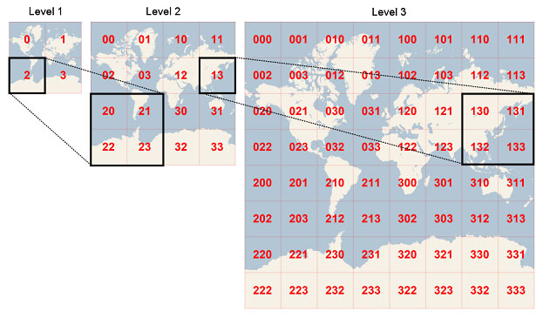
Applications of Quad-Tree

Slide 25
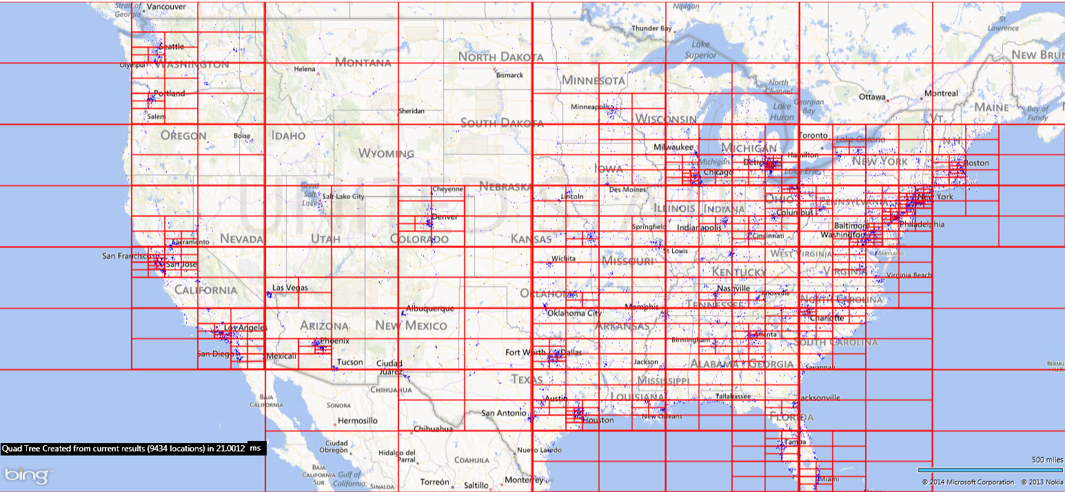
Applications of Quad-Tree
Source: http://softwareunwound.com/2014/03/18/adventures-in-mapping-big-data-sets-in-real-time-map-controls-part-2-enter-the-quadtree/

Slide 26
Put things together
Step1
We need to create spatial index (quad-tree) for the data we are about to process
Which data then? The point data or the polygon layer data?
Step2
What we should do to determine a point belongs to a specific polygon?
Which geospatial operation should you pick?
Step3
How can we take advantage of Hadoop Streaming API with Python
Step4
How to run our program?

